Slide 1
Supply Chain Management
Ming Chao, Director Logistics and Global Trade Compliance
November 9, 2017

Slide 2
Ming Chao Snapshot
Information Systems Management (ISM), BS, UC Santa Cruz, 2004
Master Business Administration, MBA, Santa Clara University, 2010
Infinera 2017 – Present
Currently Position – Director, Logistics and Global Trade Compliance
Held various positions in project/program management, auditing, consulting and trade compliance
Seagate, Netapp, Expeditors

Slide 3
Company Snapshot
Founded in 2000
FY16 revenue: $870.1 million
GAAP gross margin: 45.2%
Pioneer in large scale photonic integrated circuits
Vertically integrated with own fab in Sunnyvale

Slide 4



  About Infinera
Hardware Center
Beijing
Global HQ
Silicon Valley
Coherent Design
Ottawa
Metro
Stockholm
R&D Center
Bangalore
R&D, Packaging
Allentown, PA
Optical Architecture
Annapolis Junction, MD
  Innovator
  Only company to design and manufacture large-scale photonic integrated circuits (PICs)
  Provides integrated and disaggregated optical transport systems for terabit communications
  Over 500 patents filed/granted around
  technology and process innovation
  Global Leader
  Recognized for technology leadership, world-class quality and customer-centric focus accelerating time to revenue
  Comprehensive support services to
  a global customer base
  2,350+ employees around the globe focused on customer success
4 | © 2016 Infinera

Slide 5
Infinera’s Journey
2000: Infinera founded, promises to do the impossible: PICs
2007: 10G wave
market leader (47%)*, completed IPO
2012: Shipped 500G PIC-based DTN-X
2016: Introduction of Infinite Capacity Engine in Cloud Xpress 2 and new DTN-X platforms to power Cloud-scale networks
Infinera validates
interoperability
with white box
open line system
2004: Introduced industry’s first large scale PIC
2008: #1 market share in NA LH*
2017: New subsea DTN-X platforms to power cloud scale networks
New optical mobile transport solutions pave the way to 5G
Infinera Instant Network - the next generation of software defined capacity for cloud scale networks
2000
…
2004
2005
…
2007
2008
…
2010
…
2012
2013
2014
2015
2016
2017
2005: Shipped 10G PIC-based DTN, rapidly reaches $100M
2010:
Leapfrogs 40G, invests in 100G
2014: Introduced Cloud Xpress for DCI
2015: Introduced Sliceable Photonics
Infinera acquires Transmode
* Dell’Oro DWDM Long Haul Reports

Slide 6
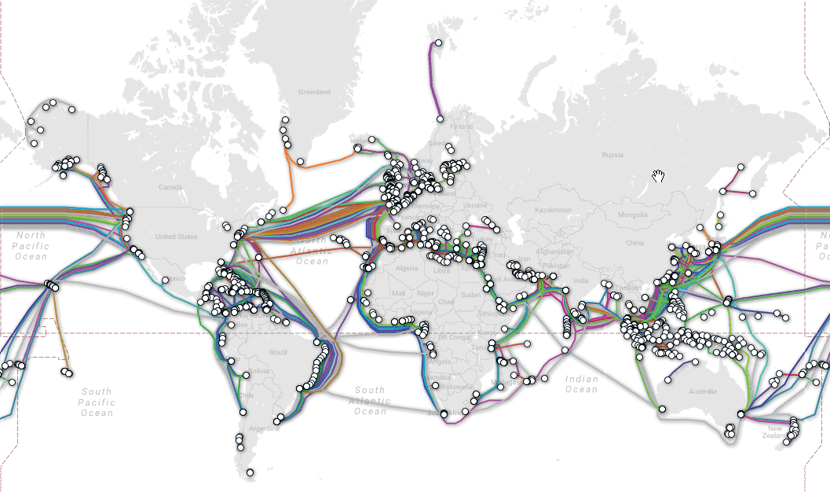
Submarine Cable
https://www.submarinecablemap.com/

Slide 7
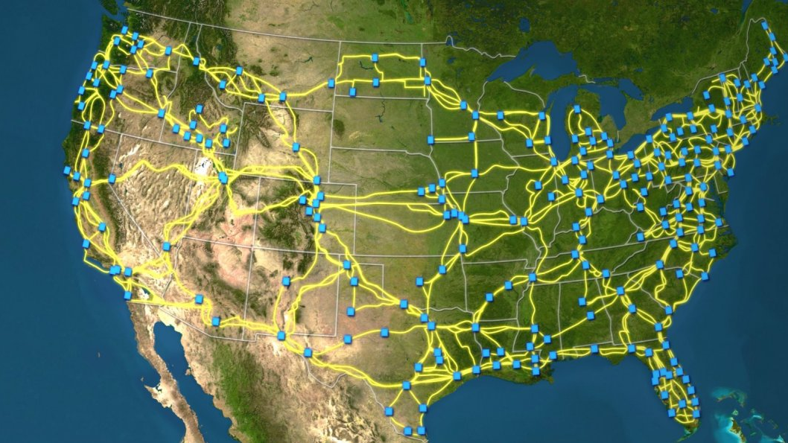
US Long-Haul Fiber-Optic Cable Network

Slide 8
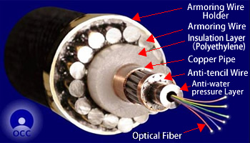
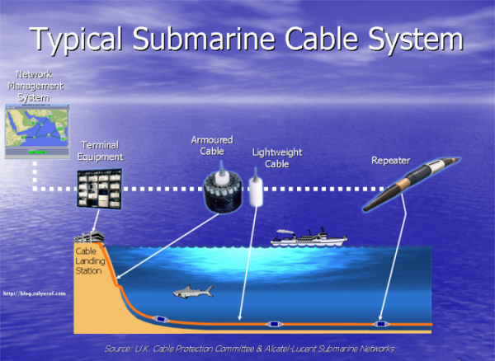
Submarine Cable

Slide 9

Landing Site

Slide 10


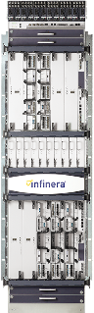



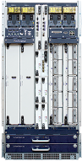

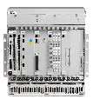
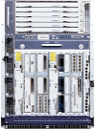
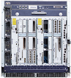










Infinera Unified End-to-End Portfolio
INFINERA XCEED SOFTWARE SUITE AND DNA
METRO
LONG-HAUL / SUBSEA
XTC-10
Mobile
Front/Backhaul
ACCESS
AGGREGATION
REGIONAL
CORE
XTC-4
Triple Play
XTC-2E
XTG Series
TM-3000
XTC-2
Cable
Broadband
NID
EDU
TM-301
TM-102
XTM Series
DTN-X Family: XTC Series
Business
Ethernet
CX
XT-500
XT/S-3600
CX 2
XT/S-3300
Cloud Xpress Family
DTN-X Family: XT /S Series
Data Center
DC INTERCONNECT
INFINERA OPEN FLEXIBLE GRID LINE SYSTEM
Notes:
Unified Management through an end to end SDN capability coupled with a single Infinera NMS platform

Slide 11

Fully Addressing the Optical Transport Market
Infinera Position
Long-haul
100G
  #1 Worldwide Long-haul 100G
  Market Share Excluding
  China (2012-2016)
Data Center Interconnect
  #1 Worldwide Purpose-Built
  DCI Market Share (2016)
Metro
  #1 Worldwide Metro 100G Ports
  Growth (2015 Over 2016)
Sources: Dell’Oro 020A Long Haul Vendor Table Q4-16, assumes 50% of Huawei & ZTE revenue in China; Ovum Market share spreadsheet 4Q16 and 2016 Global ON;
Dell’Oro 019A Metro Vendor Table Q4-16

Slide 12

Global Customer Base Across Optical Transport Markets
  Over 600 customers spanning six continents
  Three of the
  top four
  Internet Content Providers
  Leading North America and
  Pan-European wholesale operators
  Six of the
  top seven
  global cable operators
  Tens of thousands of km of submarine cable lit

Slide 13





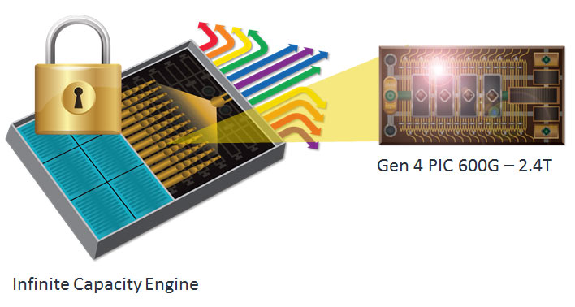



Technology Leadership
Infinera Uniquely Delivers Massive Scale
Time as a Weapon
Customer-Centric Focus
World-Class Quality
Technology Leadership
The
Infinera
Experience
Conventional Approach
Industry’s only large-scale photonic integrated circuit
Moore’s Law-like for Optical

Slide 14
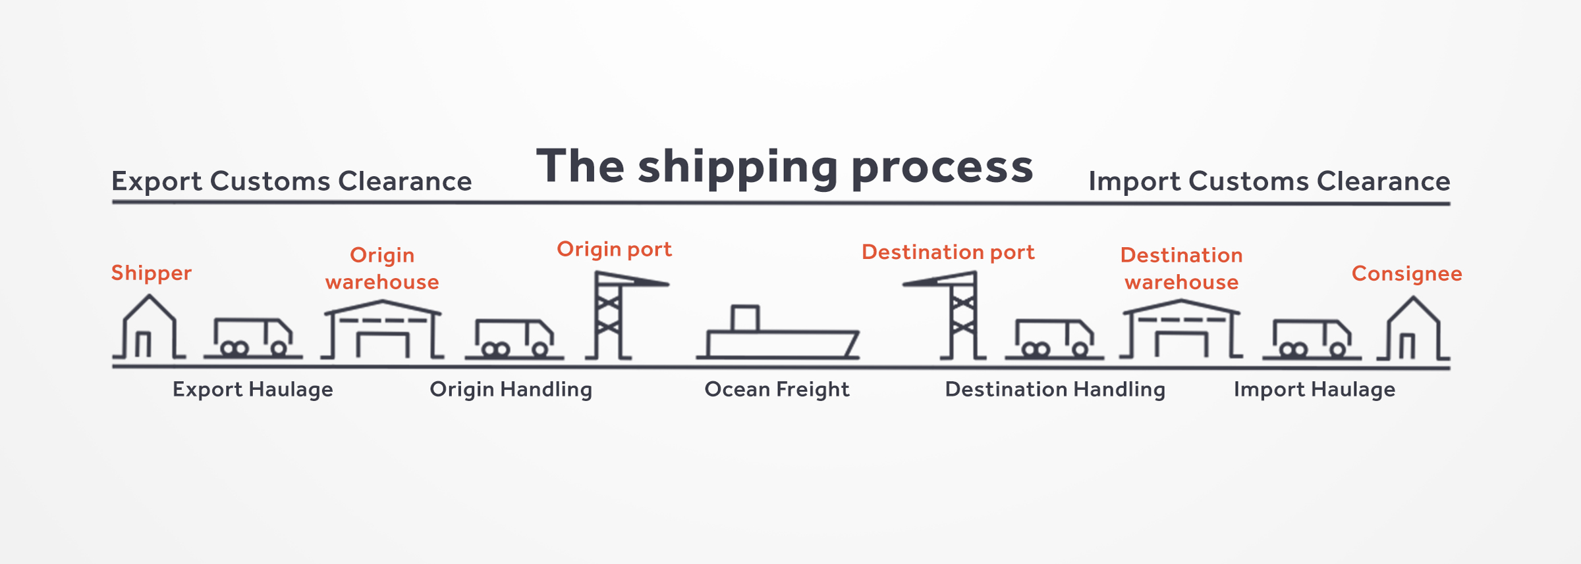

Slide 15
US Export Control Overview
All US designed products are controlled by the U.S. Export Administration Regulations (EAR) regardless of the country of manufacture or shipping point
Any item sent from the U.S. to a foreign destination is an export – subsequent transfers are re-exports.
Includes tangible and intangible transfers
Includes foreign-origin items exported, transmitted, or transshipped from the U.S.
Includes release of technology to foreign nationals

Slide 16
Export Control Overview
The U.S. Bureau of Industry and Security (BIS) is responsible for implementing and enforcing the EAR.
The EAR regulates the export and re-export of most commercial items including items that can be used for both civil and military purposes
Other U.S. government agencies regulate more specialized exports.

Slide 17
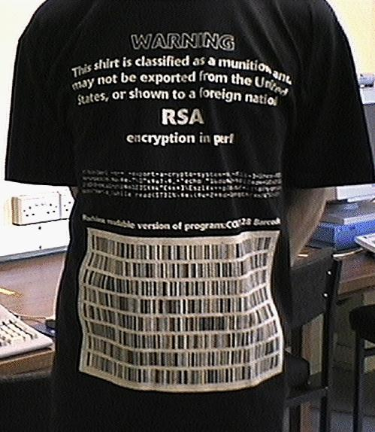
Encryption Products
In some cases encryption products require a one-time government technical review prior to export
Some countries regulate the import or export of encryption products
    China
    Russia
    Hong Kong

Slide 18
China Encryption Control
Encryption technology is regulated by the Office of State Commercial Cryptography Administration (OSCCA), and only OSCCA-approved products are sanctioned for use in China.
OSCCA also requires any company or individual selling encryption products in China to first obtain approval.
No foreign encryption technology is allowed to be sold in China, even by OSCCA-approved retailers.

Slide 19
Russia Encryption Control
Encryption technology is regulated by the Federal Security Service (FSB)
FSB requires any company or individual selling, importing and using encryption products to first obtain approval.
Crypto tools must be certified
Requiring western tech companies to allow source code review for products such as firewalls, anti-virus applications and software containing encryption before permitting the products to be imported and sold in the country.
https://www.cnbc.com/2017/06/23/under-pressure-western-tech-firms-bow-to-russian-demands-to-share-cyber-secrets.html

